Slide 1
<Company Name>
User Journey Template for Integrating with Sign with Singpass
Version 3.2

Slide 2
Instructions
This template document will guide you through creating your new user journey with Sign.
A typical successful user journey flow takes place in 7 steps:
[Partner’s Site] Instruction for user to sign document using Singpass Sign.
[Singpass] User is redirected to Sign Landing page with Login with Singpass.
[Singpass] User logs in
[Singpass] User reviews document
[Singpass] User signs using the QR code
[Singpass] Success page indicating that the document is signed. User clicks “Leave Sign portal”
[Partner’s Site] User is redirected back to partner’s site to continue transaction.
Please use this template to show how you are integrating Singpass Sign with your digital service(s) in either mobile or desktop view. Do submit your user journey in PDF format. Submissions that are not in this format will not be processed.

Slide 3
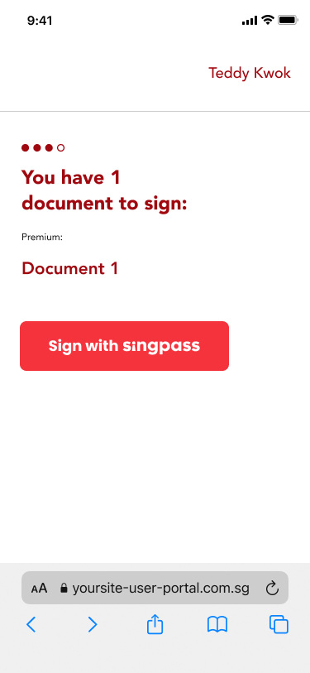
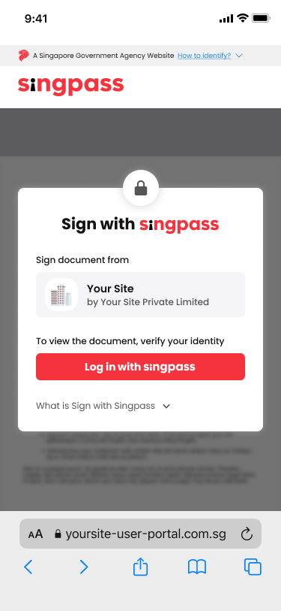
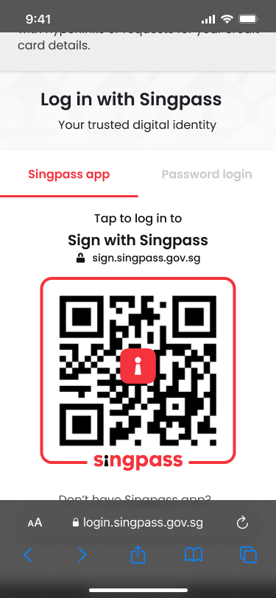
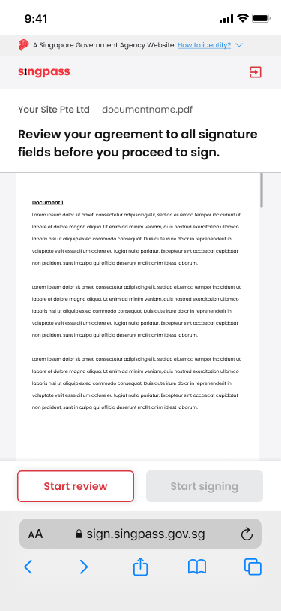
Example (1/2)
1. Sign document with Singpass Sign
2. Sign Landing page
3. Singpass Login page
4. Start document review
Partner’s Site
Partner’s Site
Singpass Site
Singpass Site

Slide 4
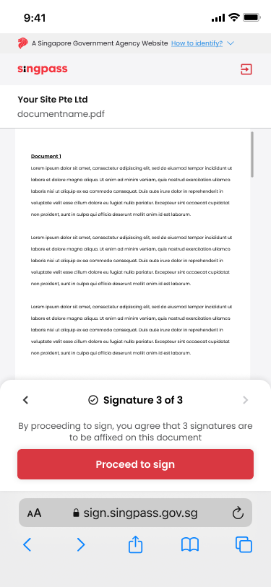
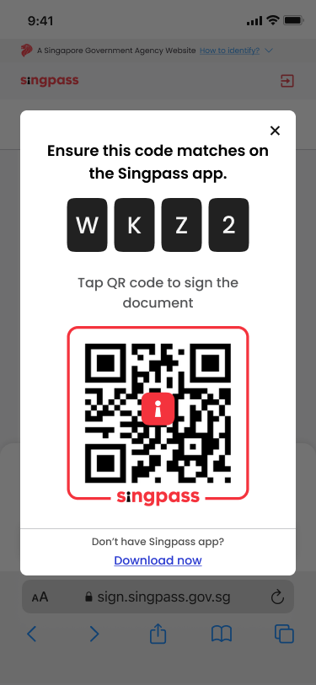
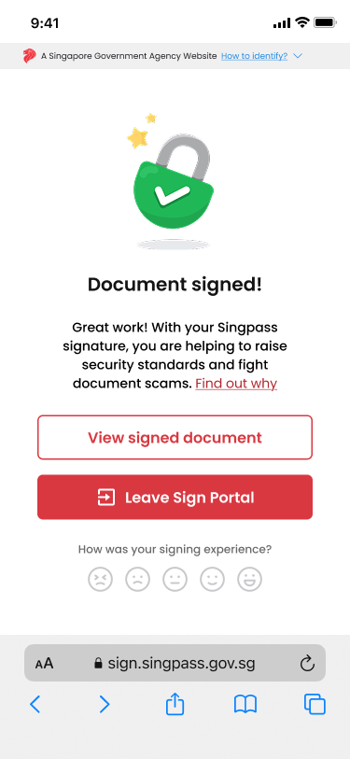
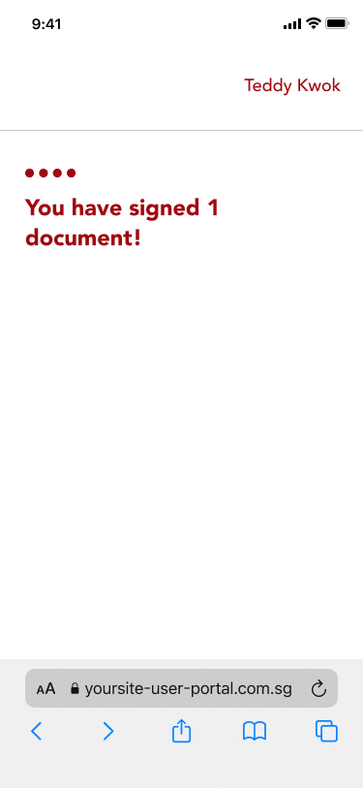
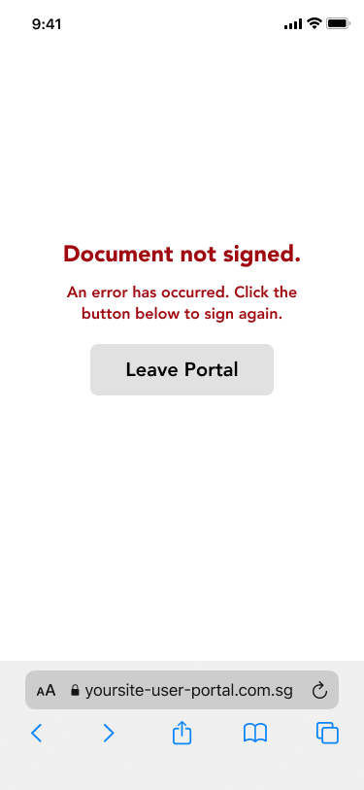
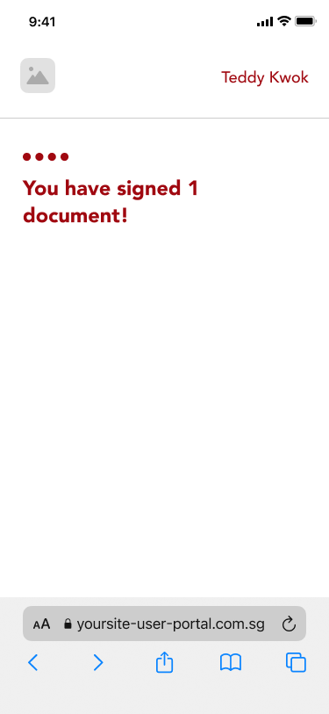
Example (2/2)
5a. Proceed to sign
5b. Singpass QR Code to verify signature
6. Document successfully signed
7. Redirect back to partner’s site
Unsuccessful Flows
Singpass Site
Singpass Site
Singpass Site
Partner’s Site
Partner’s Site

Slide 5

Key Guidelines
Please follow the guidelines below to ensure signers are well-guided through their signing journey.
Upload a display logo in PNG format from 256 x 256px to 512 x 512px.
Ensure that the correct application name is registered on the Singpass Developer Portal as it will be displayed in the Sign Landing page.
256px -512px
256px -512px
For more information, please refer to our UX guidelines here. (TBC link)
Notes:
For branding guidelines, direct RPs to the Singpass button guidelines

Slide 6
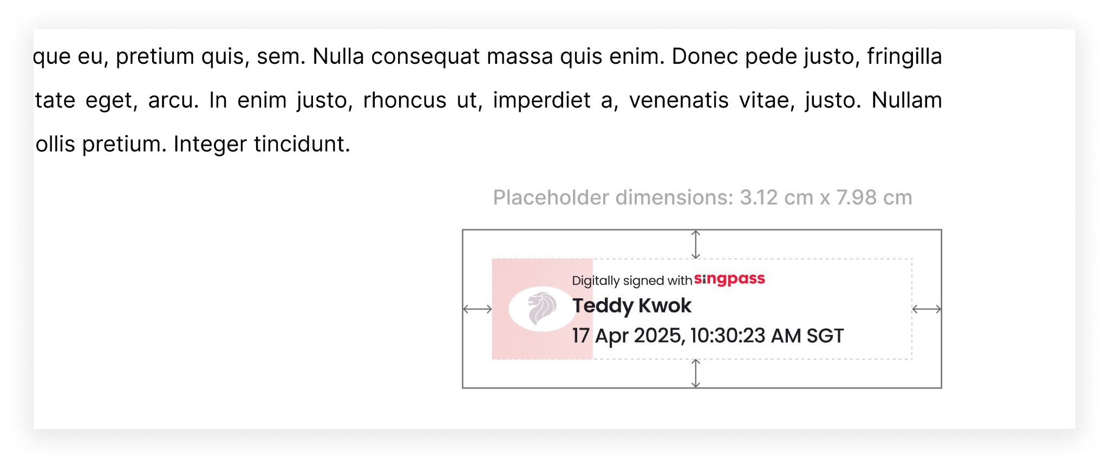
Key Guidelines
Please follow the guidelines below to ensure signers are well-guided through their signing journey.
When preparing a PDF of the unsigned document, clearly demarcate the placements of the signatures and mark a sufficient area (at least 3.12 x 7.98cm) for the signature placeholders to appear. This ensures that the document's content will not be obscured by the digital signature.
Additionally, you can use the Sign Location helper to determine signature coordinates within your pdf documents. You can find it here.
For more information, please refer to our UX guidelines here. (TBC link)
Notes:
For branding guidelines, direct RPs to the Singpass button guidelines

Slide 7




Media library
You can use the images below to create your reference journey.
Sign with Singpass button (medium size - 48H x 190W)
Sign with Singpass button (small size - 36H x 165W)
Notes:
For branding guidelines, direct RPs to the Singpass button guidelines

Slide 8
Reference journey example

Slide 9
Example
1
Partner Webpage/App showing Sign with Singpass button
Requirements ✅
Screenshot of your site showing the Sign with Singpass button
Button should meet our UX guidelines
Recommendation ⭐
Provide an alternative signing method if user does not have Singpass

Slide 10
Example
2
Sign Landing Page with Application & Entity Name
Requirements ✅
Screenshot of the Sign Landing Page
Application Name should correspond to the site/application that the user was on before being redirected to Singpass

Slide 11
Example
3
User logs in
** Do not remove or change this page

Slide 12
Example
4
User reviews the document
Requirements ✅
PDF viewer showing the document(s) that you will be asking users to sign
If you will have more than one document template, feel free to include multiple screenshots

Slide 13
Example
5
User proceeds to sign the document
** Do not remove or change this page

Slide 14
Example
6
Success page indicating that the document is signed. User clicks “Leave Sign portal”
** Do not remove or change this page

Slide 15
Example
7
User is redirected back to partner’s site to continue transaction
Requirements ✅
Show the page that users are expected to see when they are redirected back to your portal after successfully signing the document
If you have different potential outcomes (e.g. for different redirect URLs), feel free to include multiple screenshots

Slide 16
Example
Unsuccessful Flows
There may be scenarios where the user is redirected back to your site without successfully completing the signing (e.g. exit halfway; failed delivery to your webbook)
Requirements ✅
Screenshots of what your user will see if they had an unsuccessful signing attempt with Singpass
e.g. error screen with relevant instructions displayed
e.g. error modals (if any)

Slide 17
Reference journey template
You are allowed to upload either mobile or desktop views for submission.

Slide 18
1
The option to use Sign should consist of a button for user to click to
Partner Webpage/App showing Sign with Singpass button
Requirements ✅
Screenshot of your site showing the Sign with Singpass button
Button should meet our UX guidelines
Recommendation ⭐
Provide an alternative signing method if user does not have Singpass

Slide 19
2
Provide a screenshot of the Sign landing page with your application and entity name in Staging environment
Sign Landing Page with Application & Entity Name
Requirements ✅
Screenshot of the Sign Landing Page
Application Name should correspond to the site/application that the user was on before being redirected to Singpass

Slide 20
3
User logs in
** Do not remove or change this page

Slide 21
4
Provide a screenshot of your document page in Staging environment
User reviews the document
Requirements ✅
PDF viewer showing the document(s) that you will be asking users to sign
If you will have more than one document template, feel free to include multiple screenshots

Slide 22
5
User proceeds to sign the document
** Do not remove or change this page

Slide 23
6
Success page indicating that the document is signed. User clicks “Leave Sign portal”
** Do not remove or change this page

Slide 24
7
Provide a screenshot of your page in Staging environment
User is redirected back to partner’s site to continue transaction
Requirements ✅
Show the page that users are expected to see when they are redirected back to your portal after successfully signing the document
If you have different potential outcomes (e.g. for different redirect URLs), feel free to include multiple screenshots

Slide 25
Unsuccessful Flows
Provide a screenshot of relevant page(s) in Staging environment
There may be scenarios where the user is redirected back to your site without successfully completing the signing (e.g. exit halfway; failed delivery to your webbook)
Requirements ✅
Screenshots of what your user will see if they had an unsuccessful signing attempt with Singpass
e.g. error screen with relevant instructions displayed
e.g. error modals (if any)

